Slide 1
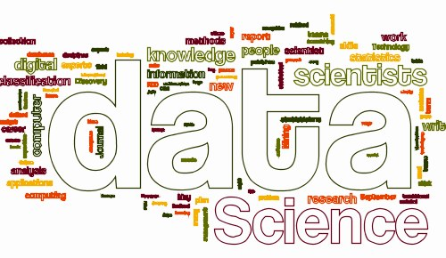
CSC 1315!
Data Science
Lecture 18

Slide 2
Interactive Data Analysis with pandas
Based on:
Learning IPython for Interactive Computation and Visualization by C. Rossant
Notes:
Useful skill
Important tool
Window into corners of everyday life

Slide 3
Data Analysis with pandas
In this lecture, we will cover the following topics:
Exploring a dataset in the Notebook
Manipulating data
Complex operations
We'll see how to load, explore, and visualize a real-world dataset with pandas, matplotlib, and seaborn, in the Notebook.
We will discuss the basic pandas functionality + data structures
We will also perform data manipulations efficiently.
Notes:
Useful skill
Important tool
Window into corners of everyday life

Slide 4
The Original dataset
Here, we will explore a dataset containing the taxi trips made in New York City 2013.
Maintained by the New York City Taxi and Limousine Commission,
This 50GB dataset contains the date, time, geographical coordinates of pickup and drop-off locations, fare, and other information for 170 million taxi trips
Notes:
Useful skill
Important tool
Window into corners of everyday life

Slide 5
The subset of the dataset
To keep the analysis times reasonable we will analyze a subset of this dataset containing 0.5% of all trips (about 850,000 rides).
Compressed, this subset data represents a little less than 100MB.
You will find the data subset we will be using in this part in the minibook folder.
The original 50GB dataset contained 24 zipped CSV files (a data and a fare file for every month).
A Python script was used to go through all of these files and extracting one row out of 200 rows.
Then, the rows were ordered by chronological order (using the pickup time).
All rows with inconsistent coordinates has bee removed.
The coordinates of a rectangle surrounding Manhattan has been defined (to restrict to this area only the rows where both pickup and drop-off locations were within this rectangle has been kept)
Notes:
Useful skill
Important tool
Window into corners of everyday life

Slide 6
Using data science libraries
Let's import a few packages we will need
import numpy as np
import pandas as pd
import matplotlib.pyplot as plt
%matplotlib inline
It is common practice to import NumPy and assign it the np alias.
Same for pandas with pd
And for matplotlib's interface named pyplot with plt
The %matplotlib inline tells matplotlib to render figures as static images in the Notebook
Notes:
Useful skill
Important tool
Window into corners of everyday life

Slide 7
Using the data subsets
Move to the chapter2 subdirectory in the minibook's directory
Download the data subset, available on the book's data
https://github.com/ipython-books/minibook-2nd-data and extract it in the current directory.
nyc_data.csv contains information about the rides
nyc_fare.csv contains information about the fares
Notes:
Useful skill
Important tool
Window into corners of everyday life

Slide 8
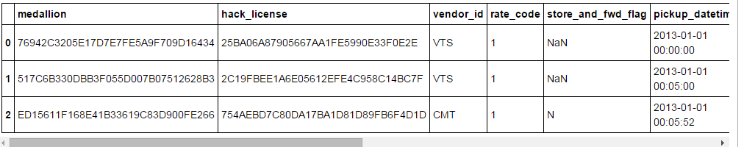
Reading files
data_filename ='data/nyc_data.csv'
fare_filename ='data/nyc_fare.csv'
Pandas provides a powerful read_csv() function that can read virtually any CSV file
Here we just need to specify which columns contain the dates so that pandas can parse them correctly
data = pd.read_csv(data_filename, parse_dates=['pickup_datetime', 'dropoff_datetime'])
fare=pd.read_csv(fare_filename, parse_dates=['pickup_datetime'])
data.head(3)
The head() method of DataFrames displays the first few lines

Slide 9
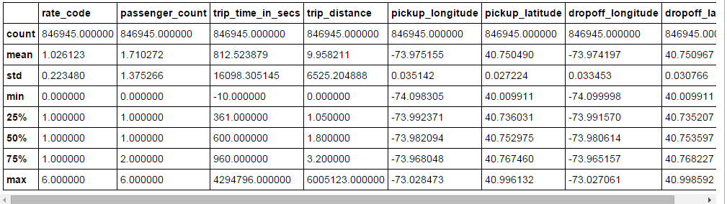
Displaying the dataset
Similarly, the tail() method displays the last few lines of a DataFrame
The describe() method shows basic statistics of all columns

Slide 10
Making plots with matplotlib
Visualizing raw data often allows us to get a general idea about the dataset.
Here we will display the pickup and dropoff locations of all trips
data.columns
Out[8]:
Index(['medallion', 'hack_license', 'vendor_id', 'rate_code', 'store_and_fwd_flag', 'pickup_datetime', 'dropoff_datetime', 'passenger_count', 'trip_time_in_secs', 'trip_distance', 'pickup_longitude', 'pickup_latitude', 'dropoff_longitude', 'dropoff_latitude'], dtype='object')
Four columns mention latitude and longitude
We load these columns
p_lng = data.pickup_longitude
p_lat = data.pickup_latitude
d_lng = data.dropoff_longitude
d_lat = data.dropoff_latitude

Slide 11
Selecting columns
With pandas, every column of a DataFrame can be obtained with the mydataframe.columnname syntax.
An alternative syntax is mydataframe['columnname'].
We created four variables with the coordinates of the pickup and dropoff locations.
These variables are all Series objects
p_lang generates:
0 -73.955925
1 -74.005501
2 -73.969955
3 -73.991432
4 -73.966225
5 -73.955238
6 -73.985580
…….
Series is an indexed list of values
So, a DataFrame is a collection of Series columns

Slide 12
Coordinate into pixels
Before we can make a plot, we need to get the coordinates of points in pixels instead of geographical coordinates.
We use the following function (Mercator projection).
def lat_lng_to_pixels(lat, lng):
lat_rad = lat*np.pi / 180.0
lat_rad = np.log(np.tan((lat_rad + np.pi / 2.0) / 2.0))
x = 100 * (lng + 180.0) / 360.0
y= 100 * (lat_rad - np.pi) / (2.0 * np.pi)
return(x,y)
NumPy implements many math functions.
They work on scalar numbers and also on pandas objects such as series
The following function call returns two new series px and py.
px, py = lat_lng_to_pixels(p_lat, p_lng)
Notes:
Useful skill
Important tool
Window into corners of everyday life

Slide 13
The px Series
In [7]:
px In [7]:
0 29.456688
1 29.442916
2 29.452790
3 29.446824
4 29.453826
5 29.456878
6 29.448450
7 29.444608
8 29.446617
9 29.442624
10 29.452091
11 29.442427
......
Notes:
Useful skill
Important tool
Window into corners of everyday life

Slide 14
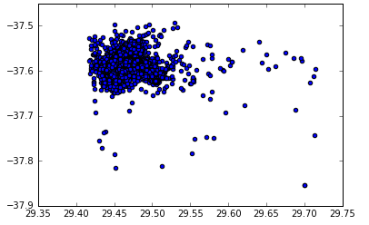
Using scatter plot
The matplotlib scater() function takes two arrays with x and y coordinates as inputs.
A scatter plot is a 2D figure showing points with various positions, sizes, color and marker shapes
The following command displays all pickup locations
plt.scatter(px, py)
In [7]:
Notes:
Useful skill
Important tool
Window into corners of everyday life

Slide 15
A customized scatter plot
In the previous scatter plot the markers are too big
Second, there are too many points,
We could make them a bit transparent to have a better of their distribution.
Third we may want to zoom around Manhattan
Forth we could make this figure bigger
And finally, we don't need the axes here.
Fortunately, matplotlib is customizable and all aspects of the plot can be changes , as shown below.
plt.figure(figsize=(16,12))
plt.scatter(px,py, s=.3, alpha=.03)
plt.axis('equal')
plt.xlim(29.40,29.55)
plt.ylim(-37.63, -37.54)
plt.axis('off')
The figure() function let us specify the figure size (in inches)
The scatter() function accepts many keyword arguments
With a small alpha value the points become nearly transparent
We use an equal aspect ratio with axis('equal')
We zoom in by specifying the limits of x and y axes.
Notes:
Useful skill
Important tool
Window into corners of everyday life

Slide 16
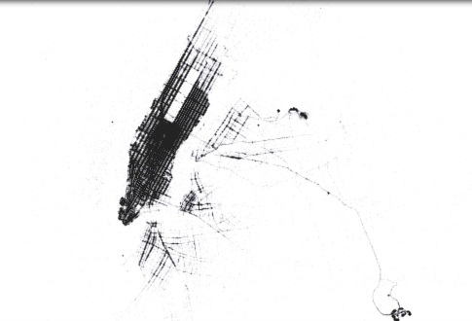
A better scatter plot
Notes:
Useful skill
Important tool
Window into corners of everyday life

Slide 17
Descriptive statistics with pandas
Common statistical measurement are one function call away in pandas
px.count(), px.min(), px.max()
(846945, 29.417137499999995, 29.714313055555561)
px.mean(), px.median(), px.std()
(29.45134580776863, 29.449418333333337, 0.009761694274451149)
In [7]:
In [7]:
Notes:
Useful skill
Important tool
Window into corners of everyday life

Slide 18
Plotting with seaborn
Matplotlib is the main plotting package in Python.
Although powerful and flexible, it sometimes require a significant amount of manual tuning to generate quality publication-ready figures.
Seaborn offers simple user interface for high-quality plotting.
First we need to install seaborn to allow us importing it
Two alternatives:
Navigate to Anaconda directory and type on the command line:
conda install seaborn
Or on the notebook"
!conda install seaborn –q –y
Then import the library
import seaborn as sns
Notes:
Useful skill
Important tool
Window into corners of everyday life

Slide 19
Plotting with seaborn
seaborn improves the aesthetics and color palettes of matplotlib figures.
It also provides several easy-to-use statistical plotting functions
We'll display a histogram of the trip distances.
Pandas provides a few simple plotting methods for DataFrame and Series
We can specify the histogram bins with the bins keyword argument
We use Numpy's linspace() function to generate 100 linearly spaced bins between 0 and 10
Notes:
Useful skill
Important tool
Window into corners of everyday life

Slide 20
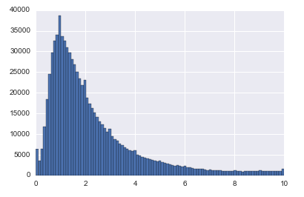
Plotting a histogram
In [8]:
data.trip_distance.hist(bins=np.linspace(0.,10.,100))
Notes:
Useful skill
Important tool
Window into corners of everyday life

Slide 21
Histograms – Simple examples
import numpy as np
import pandas as pd
import matplotlib.pyplot as plt
%matplotlib inline
a = np.random.randn(10000)
plt.hist(a, bins=np.linspace(0.,5.,50))
#b = np.random.randn(10000)
#plt.hist(b, bins=np.linspace(0.,5.,50))
#plt.hist(a,bins=np.linspace(0.,5.,50), alpha=0.5)
#plt.hist(b,bins=np.linspace(0.,5.,50), alpha=0.5)
#plt.show()
The arguments for ‘linspace’ are a start value, end value and the number of points.
Notes:
Useful skill
Important tool
Window into corners of everyday life

Slide 22
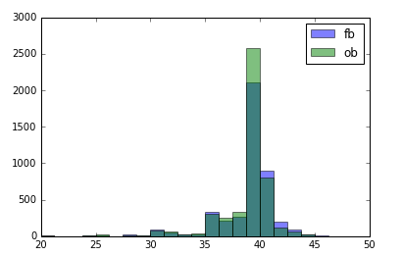
First babies histogram
To draw the histogram we need to add just the following lines to syrvey_my.py
fb,ob =summarize()
bins = numpy.linspace(20, 50, 25)
pyplot.hist(fb, bins, alpha=0.5, label='fb')
pyplot.hist(ob, bins, alpha=0.5, label='ob')
pyplot.legend(loc='upper right')
pyplot.show()
Notes:
Useful skill
Important tool
Window into corners of everyday life

Slide 23
Manipulating data
More sophisticated data manipulations methods quickly become necessary as we explore a dataset.
Here we will first see how to make selections of DataFrame.
Then we will see how to make transformations and computations of columns
Notes:
Useful skill
Important tool
Window into corners of everyday life

Slide 24
Selecting Data
Our dataset contains almost one million rows.
Only limited analyses can be done by using the whole data set.
More interesting discoveries can be made by looking at carefully-chosen subsets.
What can we say about the taxi rides done on a particular day, a particular month, or a particular day of week?
What about those starting or ending at a particular location?
A significant part of data analysis involves such fine-grained selections.
Pandas offers many facilities for selecting a subset of columns and rows.
Notes:
Useful skill
Important tool
Window into corners of everyday life

Slide 25
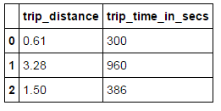
Selecting columns
Let's select a few columns
data[['trip_distance', 'trip_time_in_secs']].head(3)
The square brackets notation is used by pandas to select columns. We need two pairs of brackets because pandas expects a list of columns to select, here ['trip_distance', 'trip_time_in_secs'].
The end result is a new DataFrame containing two columns instead of 14.
In [8]:
Notes:
Useful skill
Important tool
Window into corners of everyday life

Slide 26
Selecting rows
Rows of a DataFrame are indexed;
Every row comes with a unique label (index)
Often, this label is an integer between 0 and n_rows-1
This label can be something else, like a string.
If we had a DataFrame giving information about each taxi, the label could be the taxi's medallion (or anonymized version of it).
The loc attribute of a DataFrame is used to select row(s).
Notes:
Useful skill
Important tool
Window into corners of everyday life

Slide 27
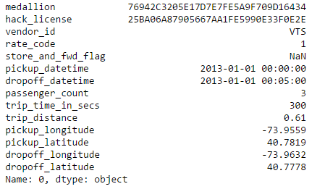
Example of a row selection
Here we select the first row.
data.loc[0]
In [8]:
Notes:
Useful skill
Important tool
Window into corners of everyday life

Slide 28
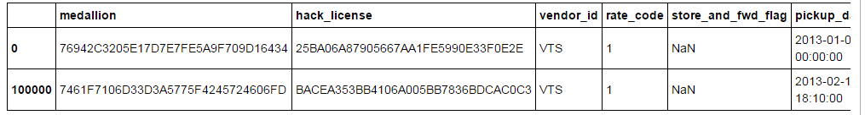
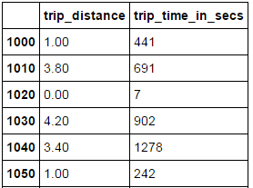
Multiple rows selection
Multiple rows can be selected by providing a list of labels
data.loc[[0,100000]]
In [8]:
We can select regularly spaced rows using slices.
Here is how to select one row out of 10 between 1000 and 2000
data.loc[1000:2000:10, ['trip_distance', 'trip_time_in_secs']]
In [8]:
Note how we combined column and row selection here.
The row selection first and the column selection second
Notes:
Useful skill
Important tool
Window into corners of everyday life

Slide 29
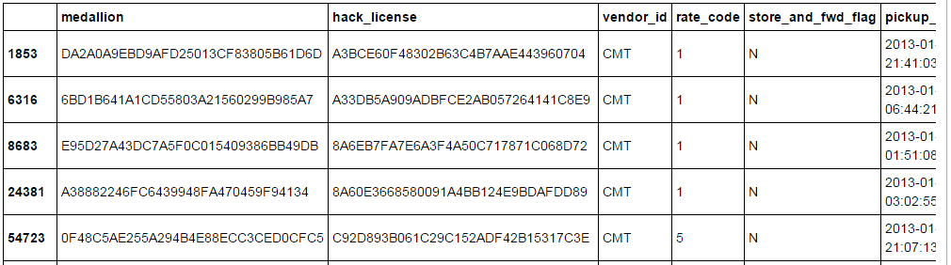
Filtering with Boolean indexing
We can select rows satisfying specified properties.
This is a more common use-case in data analysis.
Here we select the longest rides:
data.loc[data.trip_distance > 50]
In [8]:
Here data.trip_distance > 50 is a Series object containing boolean values for all rows depending on whether the trip distance is higher or lower than 50.
The loc attribute also works with booleans instead of explicit labels
It returns all rows represented by True value.
Notes:
Useful skill
Important tool
Window into corners of everyday life

Slide 30

Interactive slider
We can create slider displaying the number of rows with a distance larger than the threshold:
from ipywidgets import interact
@interact
def show_nrows(distance_threshold = (0,200)):
return len(data.loc[data.trip_distance > distance_threshold])
In [8]:
Notes:
Useful skill
Important tool
Window into corners of everyday life

Slide 31
Computing with numbers
The trip_time_in_secs column contains the trip durations in seconds.
How can we convert these values in minutes?
More generally, how can we make computations on DataFrames?
A first approach is to use a for loop, iterating over all rows and making numerical computations inside that loop.
Whereas Python loops are possible in such situations they are slow
There are faster and simpler alternatives.
Pandas allows you to perform vector operations on DataFrames and Series
They follow standard mathematical notations.
Notes:
Useful skill
Important tool
Window into corners of everyday life

Slide 32
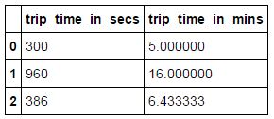
Performing vector operations
Let's add a new column containing the trip durations in minutes
data['trip_time_in_mins'] = data['trip_time_in_secs'] / 60.0
data[['trip_time_in_secs', 'trip_time_in_mins']].head(3)
In [8]:
The data.trip_time_in_secs notation represents a Series object.
pandas extends the floating point division to work with Series and DataFrames.
Here, all elements of data.trip_time_in_secs are divided by 60.
Notes:
Useful skill
Important tool
Window into corners of everyday life

Slide 33


Performing vector operations
The same notation works if we have another Series of the same size in the second term of the division.
In this case, the division occurs on an element-wise basis.
A Series object is a vector with indices
The indices determine which values are used when operating Series.
a = data.trip_distance[:5]
a
In [8]:
In [9]:
b = data.trip_distance[2:6]
b
Notes:
Useful skill
Important tool
Window into corners of everyday life

Slide 34

Performing vector operations
The previous two Series objects have different but overlapping sets of indices
Although they don't have the same size we can add them together
a + b
In [10]:
The result is a new Series object containing the aligned sum of a and b.
The set of indices of a + b is the union of indices of a and b.
When one value is missing we get an undefined value NaN.
When the indices overlap the sum is correctly computed.
This feature – alignment – makes it convenient to operate on labeled data.
Other mathematical operations work similarly.
NumPy math functions (e.g. np.log())work also on Series and DataFrames, property known as vectorization.
Notes:
Useful skill
Important tool
Window into corners of everyday life

Slide 35


Working with text
Vectorized operations can also be done on text.
data.medallion.head(3)
In [7]:
This column contains anonymized versions of the taxis' medallions.
The str attribute gives access to many vectorized string functions.
data.medallion.str.slice(0,4).head(3)
In [8]:
Series.str.slice() - slice substrings from each element in the Series
These functions are essential when you are working with datasets so large that for loop would be slow.
Notes:
Useful skill
Important tool
Window into corners of everyday life

Slide 36
Working with dates and time
Pandas provides many methods to operate on dates and times:
Getting the day, day of week, hour, etc. from dates
Selecting range of dates
Computing time ranges
Dealing with different time zones
These operations only work on Series with datetimes64 datatype or with DatetimeIndex objects (used to index values with dates or times).
In practice there are many ways to get such objects from raw data like CSV files.
Notes:
Useful skill
Important tool
Window into corners of everyday life

Slide 37
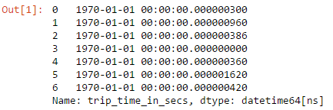
Working with dates and time
We used parse_dates keyword arguments in the pd.read_csv() function.
Another example is pd.to_datetime() function
data_filename ='data/nyc_data.csv'
d = pd.read_csv(data_filename)
t1 = d['trip_time_in_secs']
t2 = pd.to_datetime(t1)
t2.head(7)
Notes:
Useful skill
Important tool
Window into corners of everyday life

Slide 38

Working with dates and time
The dt attribute of datetime objects gives us access to datetime components
Here is how to get the day of week of the taxi trips (Monday= 0, Sunday =6)
data.pickup_datetime.dt.dayofweek[::200000]
In [8]:
The syntax [::n] means getting every n^{th} element starting at 0
Notes:
Useful skill
Important tool
Window into corners of everyday life

Slide 39
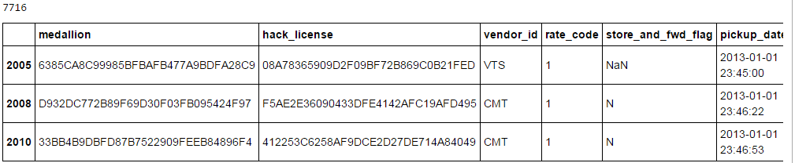
Working with dates and time
Let's select all night trips that finished the next day:
day_p = data.pickup_datetime.dt.day
day_d = data.dropoff_datetime.dt.day
selection = (day_p != day_d)
print(len(data.loc[selection]))
data.loc[selection].head(3)
In [8]:
The (day_p != day_d) expression is a Series of boolean for selecting the rows that have different pickup and dropoff days.
Notes:
Useful skill
Important tool
Window into corners of everyday life

Slide 40
Handling missing data
Real-world dataset are rarely perfect
Having missing values in a dataset is the rule rather than the exception.
Pandas provides functionality for handling missing data.
In practice you can let pandas deal with missing data.
In other time you may want control over the missing values.
You may want to discard missing data for some analysis
You may want to replace missing data with a default value
In pandas, missing data is represented by NaN (Not a Number)
Several Series and DataFrame methods are provided to deal with missing data:
isnull() indicates whether values are null or not
notull() indicates the opposite
dropna() removes missing data
fillna(some default value) replaces missing data with a default value
Notes:
Useful skill
Important tool
Window into corners of everyday life

Slide 41
Group-by
A group-by operation typically consists of one or several of the following steps:
Splitting the data into groups that share common attributes
Applying a function to every group
Recombining the results
Pandas provides user-friendly facilities to perform group-by manipulations
Notes:
Useful skill
Important tool
Window into corners of everyday life

Slide 42
Weekly statistics
For the weekly statistics in our dataset we need to split the data into weekly groups.
pandas provides the groupby() method for this purpose
weekly = data.groupby(data.pickup_datetime.dt.weekofyear)
len(weekly)
Here
data.pickup_datetime.dt.weekofyear
is a Series instance with the week number of every ride
The groupby() method returns an object with one group per value of weekofyear
Since there are 52 weeks in the year, weekly contains 52 different groups
Notes:
Useful skill
Important tool
Window into corners of everyday life

Slide 43
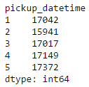
Weekly statistics
The size() method returns the number of rows in each group
y = weekly.size()
y.head(5)
Notes:
Useful skill
Important tool
Window into corners of everyday life

Slide 44
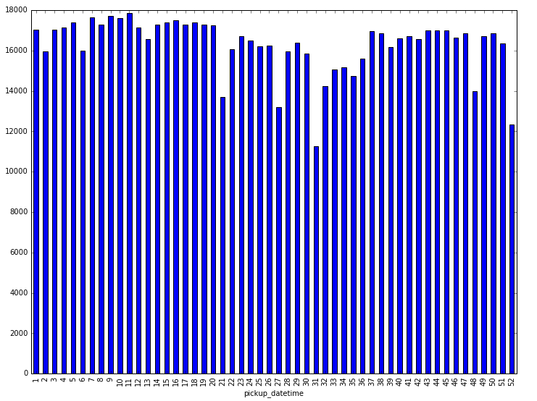
The histogram
weekly = data.groupby(data.pickup_datetime.dt.weekofyear)
y = weekly.size()
y.plot(kind="bar", figsize=(12,9))
Notes:
Useful skill
Important tool
Window into corners of everyday life

Slide 45
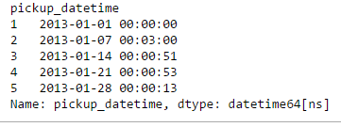
Plotting the number of rides
To create a meaningful plot we need to specify the appropriate x-axes with the dates of all 52 weeks.
x = weekly.pickup_datetime.first()
x.head(5)
This Series contains the date of the first item in every group.
Notes:
Useful skill
Important tool
Window into corners of everyday life

Slide 46
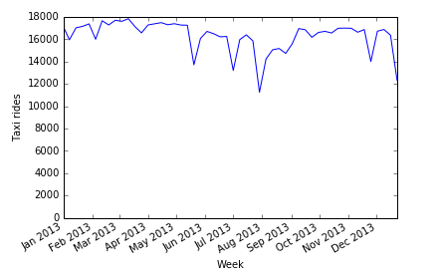
The plot
Now we create a new Series with the values in our y object, and indexed by the dates x
The plot() method of this new Series creates the plot we need
Pandas includes automatically tick resolution adjustment for regular frequency time-series
pd.Series(y.values, index=x).plot()
plt.ylim(0) # Set the lower y value to 0.
plt.xlabel('Week') # Label of the x axis.
plt.ylabel('Taxi rides') # Label of the y axis.
Notes:
Useful skill
Important tool
Window into corners of everyday life

Slide 47
Line plots
Line plots are charts used to show the change in a numeric variable based on some other ordered variable.
Line plots are often used to plot time series data to show the evolution of a variable over time.
Line plots are the default plot type when using df.plot() so you don't have to specify the kind argument when making a line plot in pandas.
Let's create some fake time series data and plot it with a line plot
# Create some data
years = [y for y in range(1950,2016)]
readings = [(y+np.random.uniform(0,20)-1900) for y in years]
time_df = pd.DataFrame({"year":years, "readings":readings})
# Plot the data
time_df.plot(x="year",
y="readings",
figsize=(9,9))
Notes:
Useful skill
Important tool
Window into corners of everyday life

Slide 48
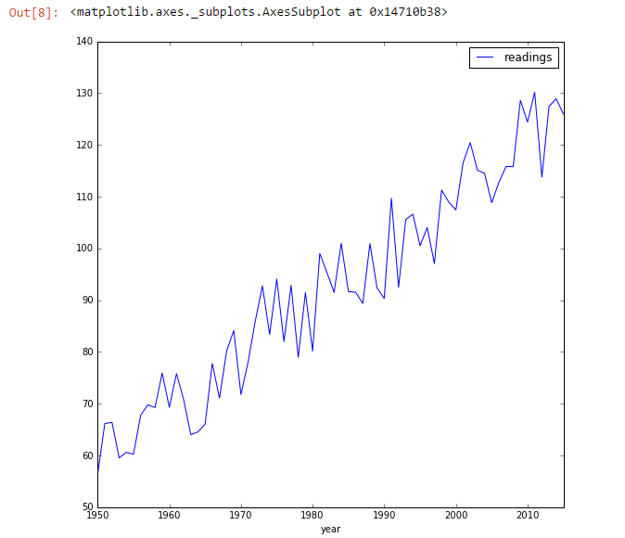
The plot
The plot for the fake series
Notes:
Useful skill
Important tool
Window into corners of everyday life

Slide 49
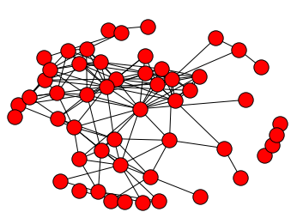
Portion of Facebook graph
import numpy as np
import pandas as pd
import matplotlib.pyplot as plt
%matplotlib inline
import networkx as nx
graph = nx.read_edgelist('3980.edges')
len(graph.nodes())
len(graph.edges())
nx.draw(graph)
plt.show()
Notes:
Useful skill
Important tool
Window into corners of everyday life

Slide 50
References
http://hamelg.blogspot.com/2015/11/python-for-data-analysis-part-17.html
Notes:
Useful skill
Important tool
Window into corners of everyday life

